Slide 1

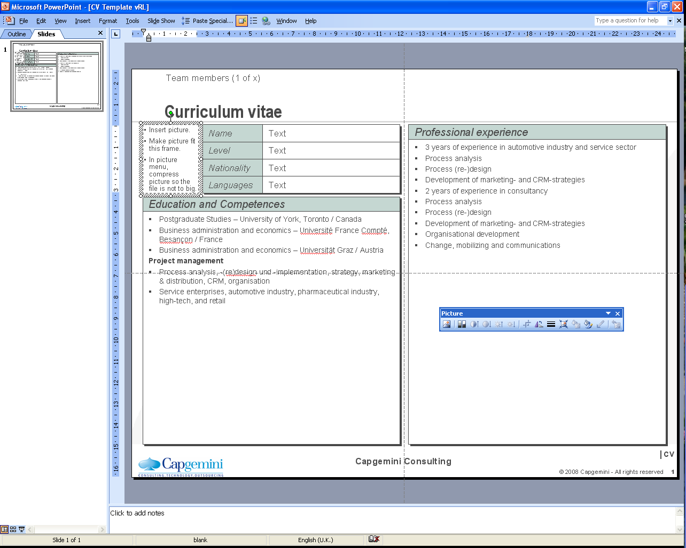

Srinivas Venugopal Transition Management Consultant
Insert picture.
Make picture fit this frame.
In picture menu, compress picture so the file is not to big.
Name
Srinivas Venugopal
Professional experience
Grade
Consultant
Srinivas Venugopal specializes in PMO Support for Client accounts and is currently engaged as PMO for SCOPE account.
PMO Experience:
Currently a PMO in SCOPE account in Chennai for a year.
Has been organising virtual & in-person Weekly / Fortnightly Operations calls with Team; monitored tasks, assigning and driving each task to closure.
Initiated and closed SCOPE specific Background verification of around 100 associates during three months transition time (SLA driven).
Handled KT Sessions for 3 re-badge batches (total associate count-around 200)
Had experience of on-boarding resources for Client assignments (including scheduling of Client interview, preparing SOW, on-boarding (SLA driven), Visa & travel Coordination through Immigration teams.
Referred around 200 profiles against eRRFs & around 75 associates against Fixed Bid projects and completed on-boarding in the last one year to SCOPE.
Have experience of coordinating timely time entry & approvals of around 90,000 Hours monthly for the last one year
Have documented detailed SOPs for SCOPE Account.
Coordination of Space, Machines, etc. allocation for on-boarded resources & keeping a track.
Industry Experience:
Manufacturing, Retail, Distribution, Insurance & Banking.
Nationality
Indian
Residence
Chennai, India
Insert picture.
Make picture fit this frame.
In picture menu, compress picture so the file is not to big.
Role
PMO Consultant
Profile
Srinivas Venugopal is a Consultant in Capgemini India. He is a Commerce graduate with around 4+ years of PMO experience in Project management.
A consistent process oriented resource, with hands on expertise in General operations roles. Conversant with the following activities in earlier Account PMO roles: Handholding Associates joining the account from Offer stage, creation of project code and mapping resources, on-boarding to Client Account (incl. mandatory Background verification initiation & closure), delivering tailor made KT Sessions for associates, ensuring time entry compliance, SOW Preparation & administration and Support in a global delivery model. Good result oriented team player with counseling, conflict resolution & negotiation skills.
Competencies
Business Transition, Transformation & Optimization
IT Service Level Management and Training
Customer Relationship Management
Global Delivery Management
ITIL Process Consultant
Education
Bachelor in Commerce –B.Com.(Costing); MBA underway (corresp) &
Project and Program Management
Certifications & Achievements
ITIL V3.0 Certified Process Consultant
© 2011 Capgemini - All rights reserved

